Slide 1
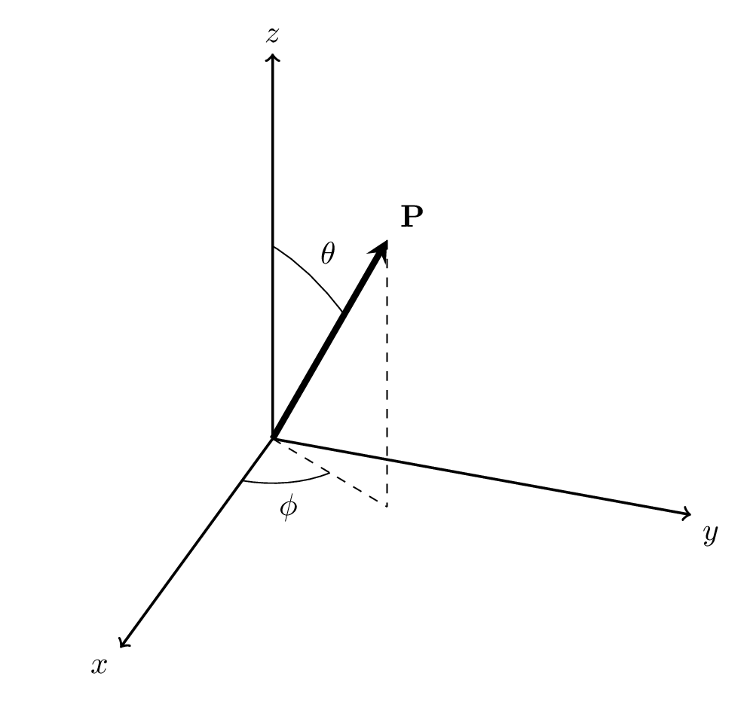



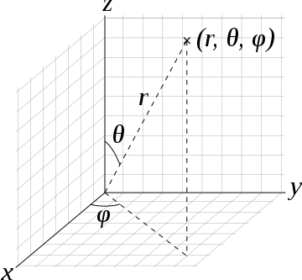



Particle at Rest
$$z$$
$$y$$
$$x$$
[rest frame]
Notes:
When the particle is in its own rest frame, we have the vector for a general point P, given in cartesian coordinates for the x,y,z directions
And in spherical polar coordinates as … with theta being the angle from the z-axis and phi being the angle from the x-axis
Theta is between 0 and pi, and phi is between 0 and 2pi

Slide 2






Particle at Rest
$$U_{z}$$
$$U_{x}$$
[rest frame]

Slide 3

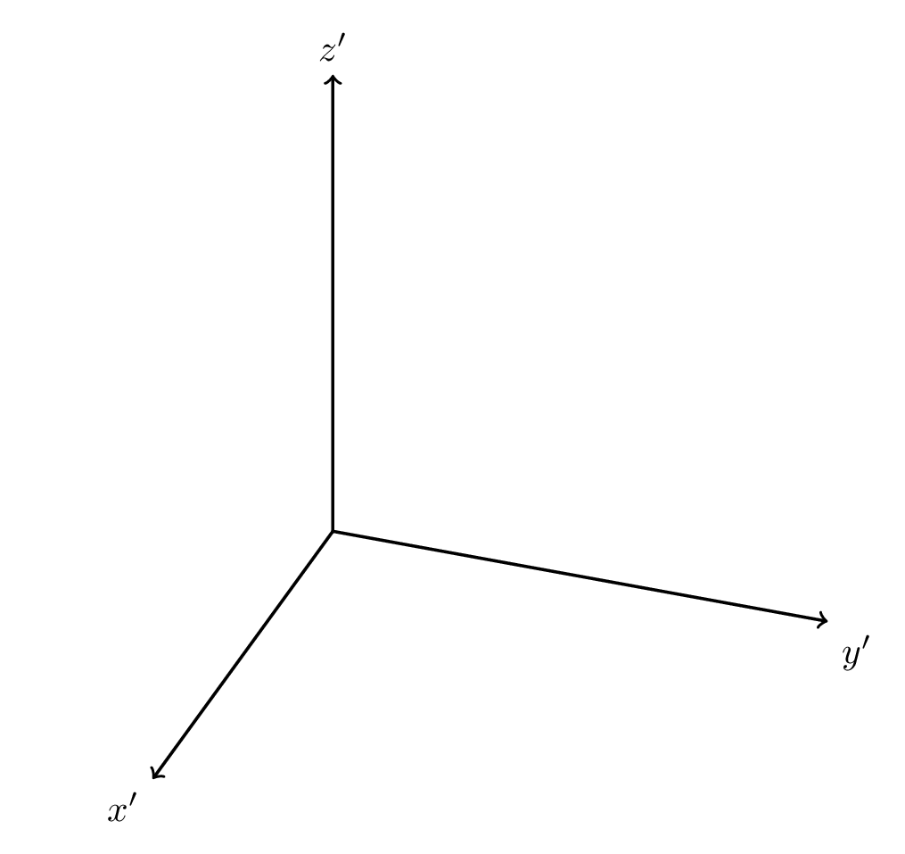










Moving Particle
$$z′$$
$$y′$$
$${\text{V}}_{p}$$
$$x′$$
$$v_{p}=− v$$
[Prime frame]

Slide 4
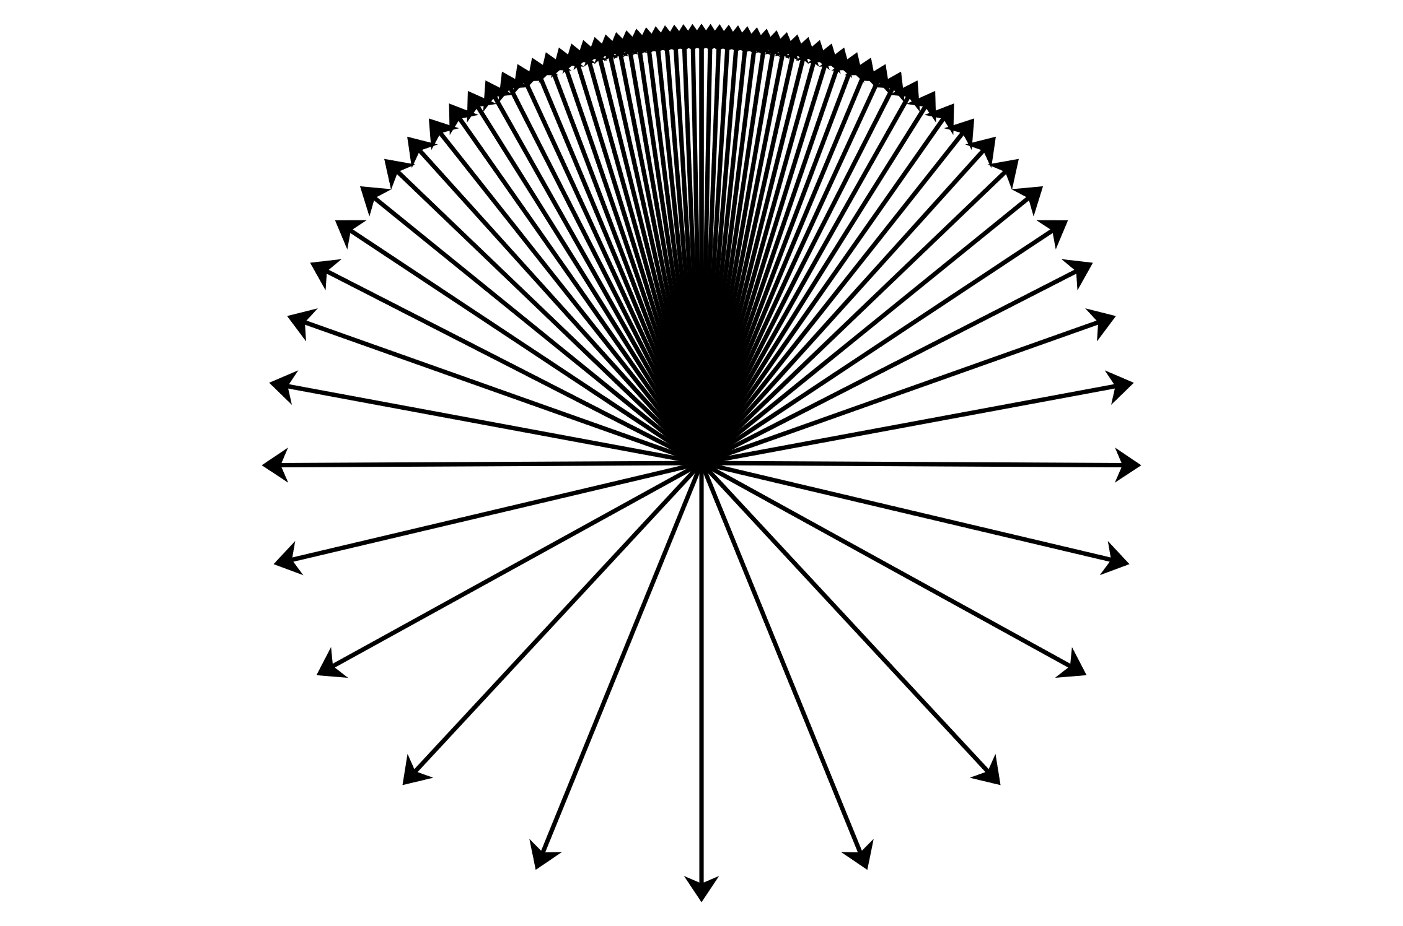


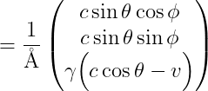



Moving Particle
$$V_{p}$$
$$U_{z}^{′}$$
$$U_{x}^{′}$$
[Prime frame]

Slide 5




Moving Particle
$$θ′$$
$$z′$$
$$y′$$
$${\text{V}}_{p}$$
$$x′$$
[Prime frame]

Slide 6
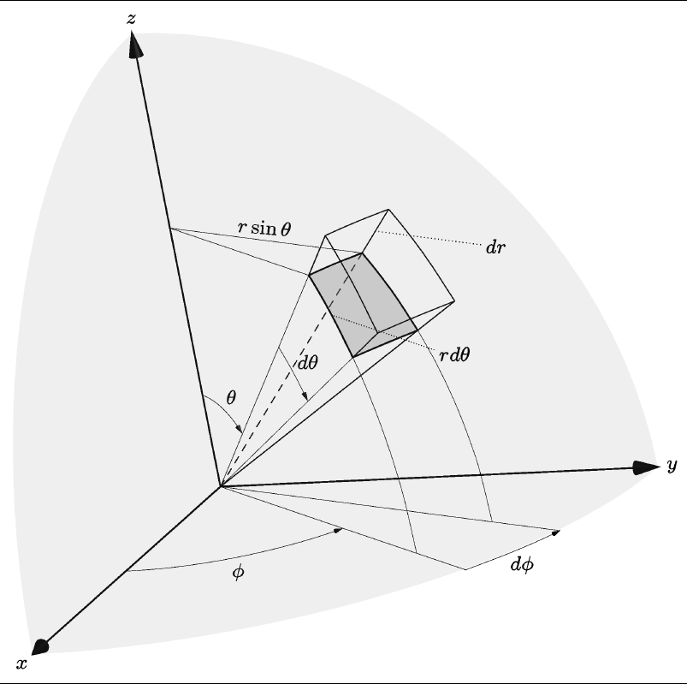

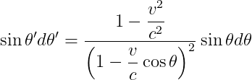




Solid Angle
$$dΩ = sinθdθdφ$$
$$dΩ^{′}= sin θ′dθ^{′}dφ^{′}$$
[Proper frame]

Slide 7



Field strength weighting
$$dΩ = sinθdθdφ$$
$$θ′$$
[Proper frame]

Slide 8


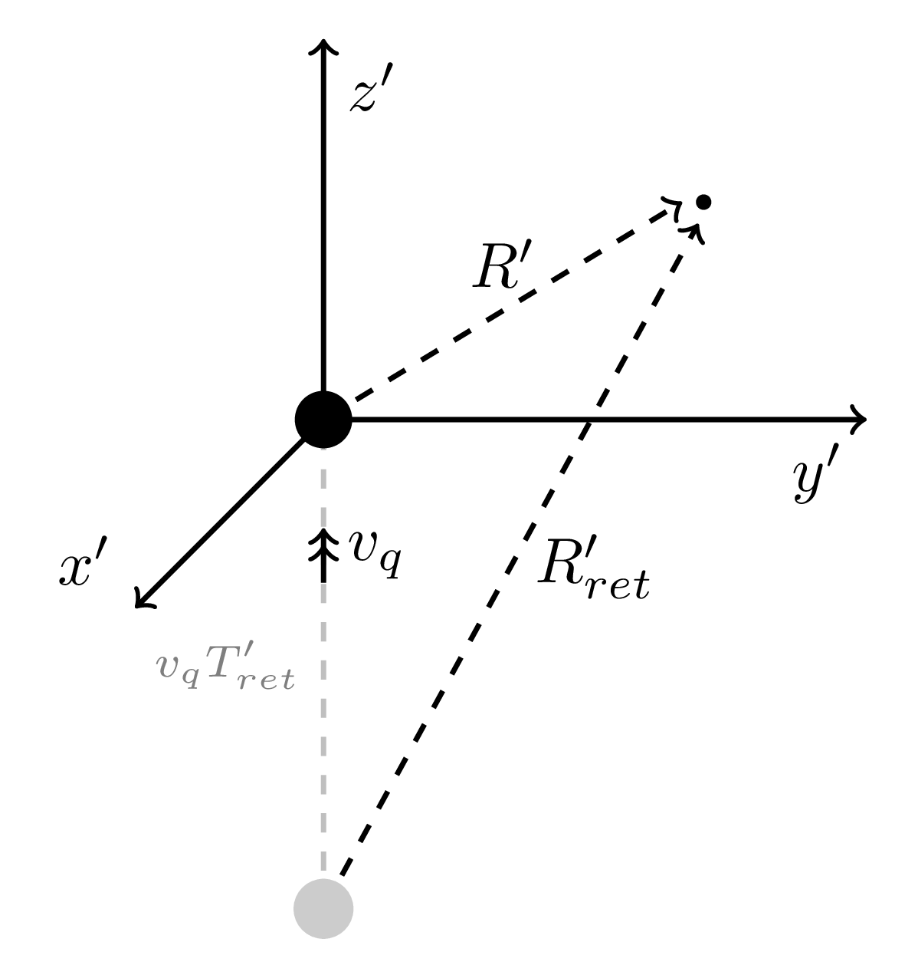






Moving Particle
[Prime frame]

Slide 9



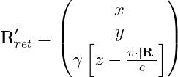
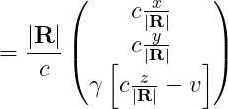
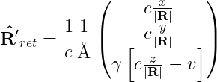
Moving Particle
[Prime frame]

Slide 10
Moving Particle
[Prime frame]

Slide 11
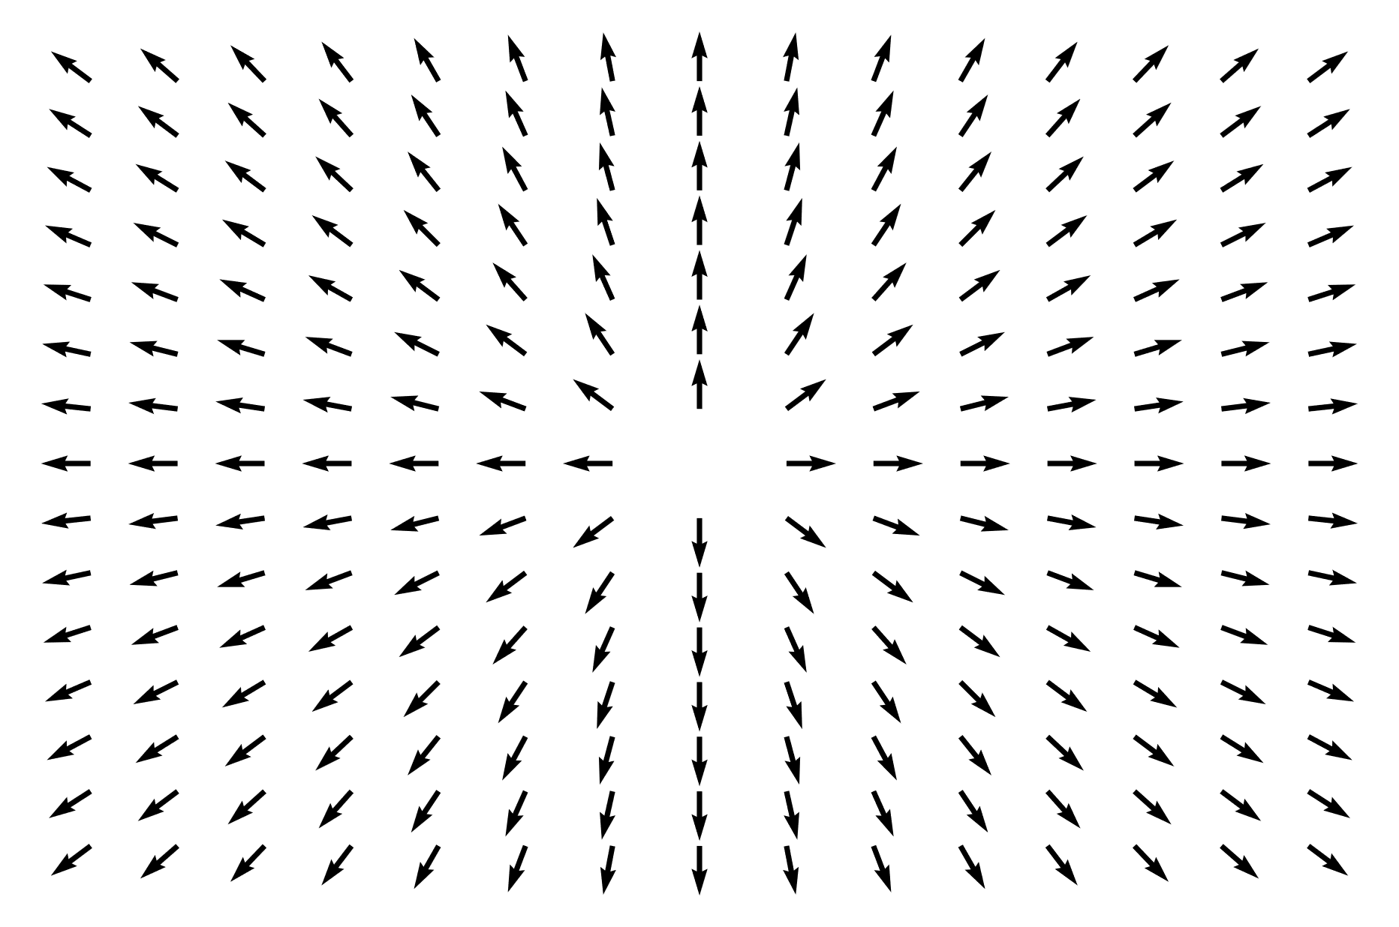
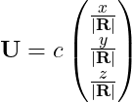



Field of Particle at Rest
$$z$$
$$y$$
$$x$$
[rest frame]
Notes:
When the particle is in its own rest frame, we have the vector for a general point P, given in cartesian coordinates for the x,y,z directions
And in spherical polar coordinates as … with theta being the angle from the z-axis and phi being the angle from the x-axis
Theta is between 0 and pi, and phi is between 0 and 2pi

Slide 12
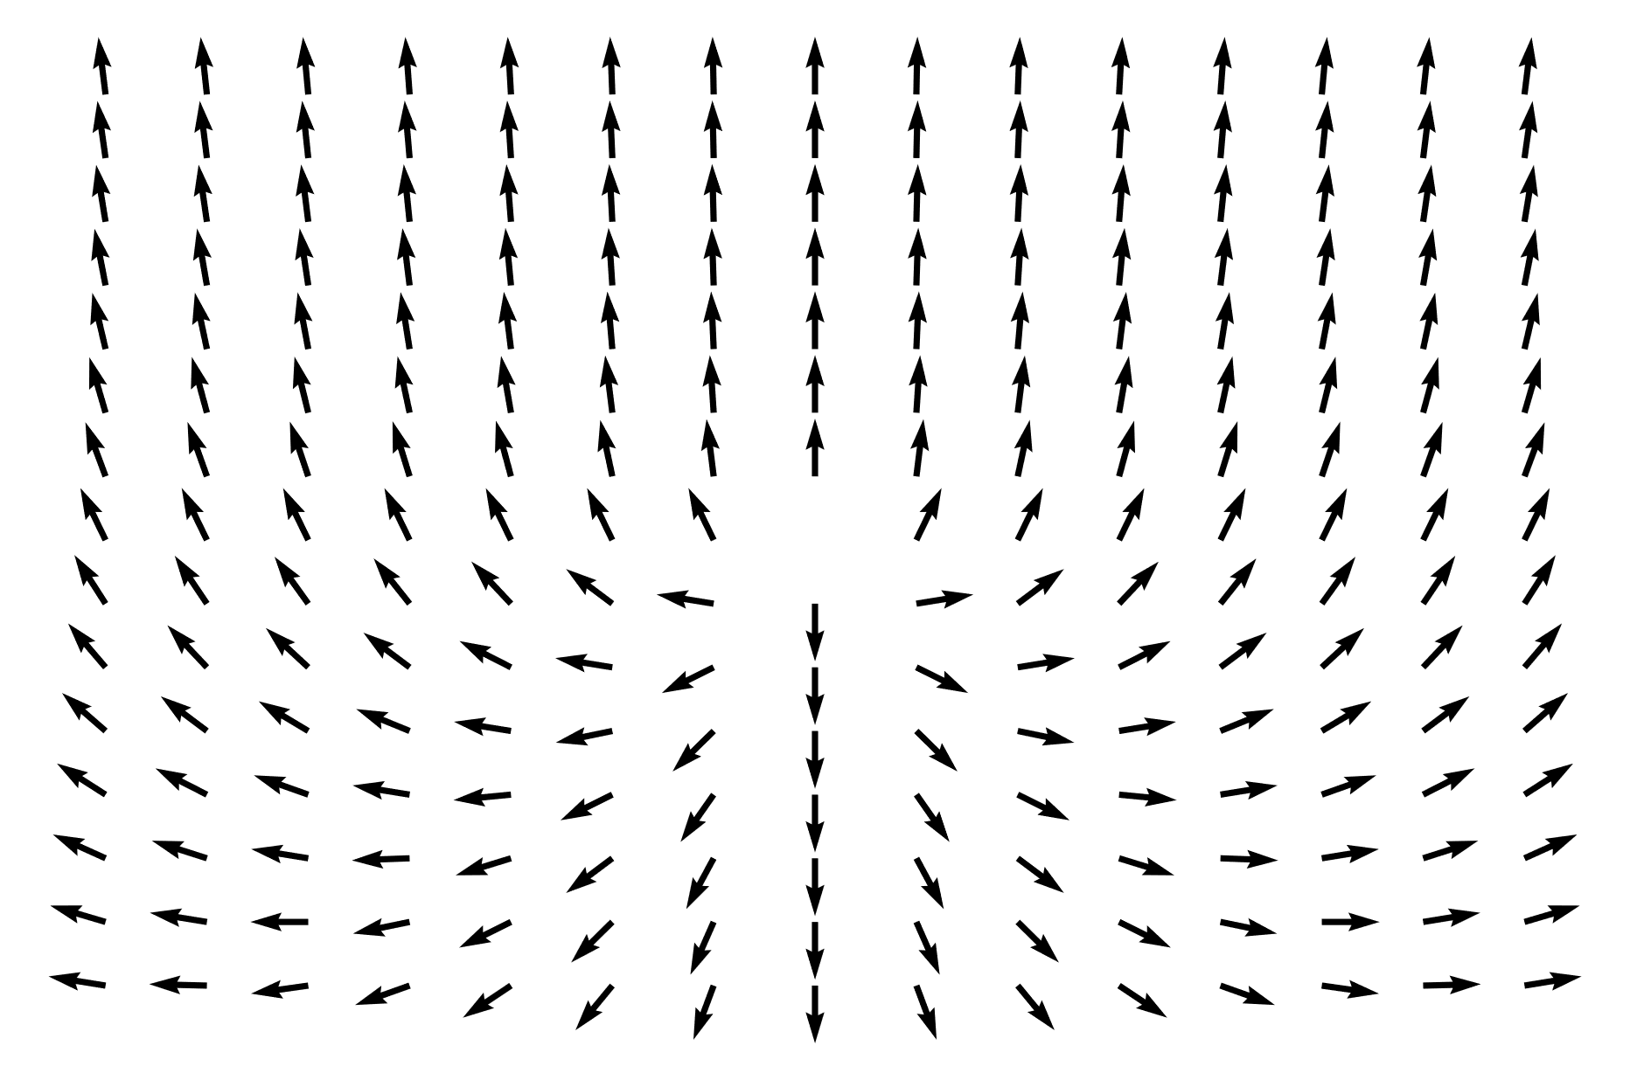
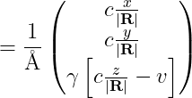
Field of Moving Particle
$$z$$
$$y$$
$$x$$
[primed frame]
Notes:
When the particle is in its own rest frame, we have the vector for a general point P, given in cartesian coordinates for the x,y,z directions
And in spherical polar coordinates as … with theta being the angle from the z-axis and phi being the angle from the x-axis
Theta is between 0 and pi, and phi is between 0 and 2pi

Slide 13


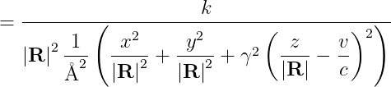
Field of Particle at Rest
Field Strength
$$z$$
$$y$$
$$x$$
[rest frame]
Notes:
When the particle is in its own rest frame, we have the vector for a general point P, given in cartesian coordinates for the x,y,z directions
And in spherical polar coordinates as … with theta being the angle from the z-axis and phi being the angle from the x-axis
Theta is between 0 and pi, and phi is between 0 and 2pi

Slide 14



Particle at Rest
Field Strength
[rest frame]

Slide 15



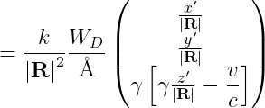

Particle at Rest
Field Strength
$${f }^{′}$$
[primed frame]

